Slide 1
Defining success in data science
Brian Caffo, Jeff Leek, Roger Peng
@bcaffo
www.bcaffo.com

Slide 2
Success versus failure in data science
Positive results of a data science experiment:
New knowledge is created
Decisions are made based on the outcome of the data analysis
Impact
Knowledge that the data cannot inform the decision or answer the question is obtained
Negative results:
Decisions are made against clear evidence
Results are equivocal
Study is underpowered so that lack of clear results cannot be ascertained to be the data or lack of an effect
Decision is not obvious
Uncertainty prevents new knowledge from being created
Plug for Data Science in Real Life course

Slide 3
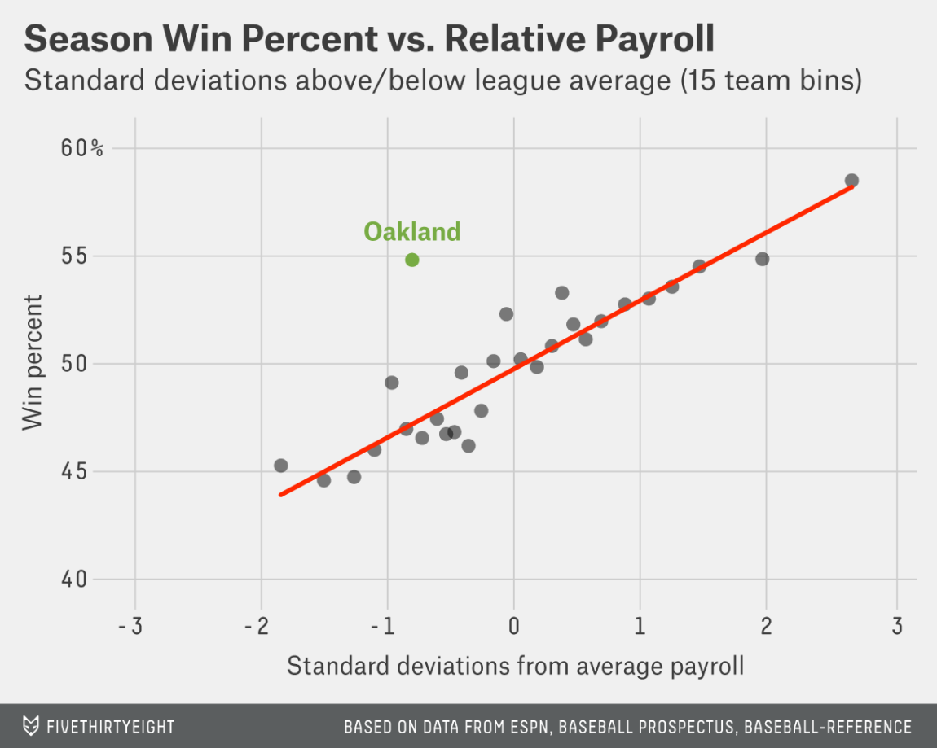

Moneyball

Slide 4
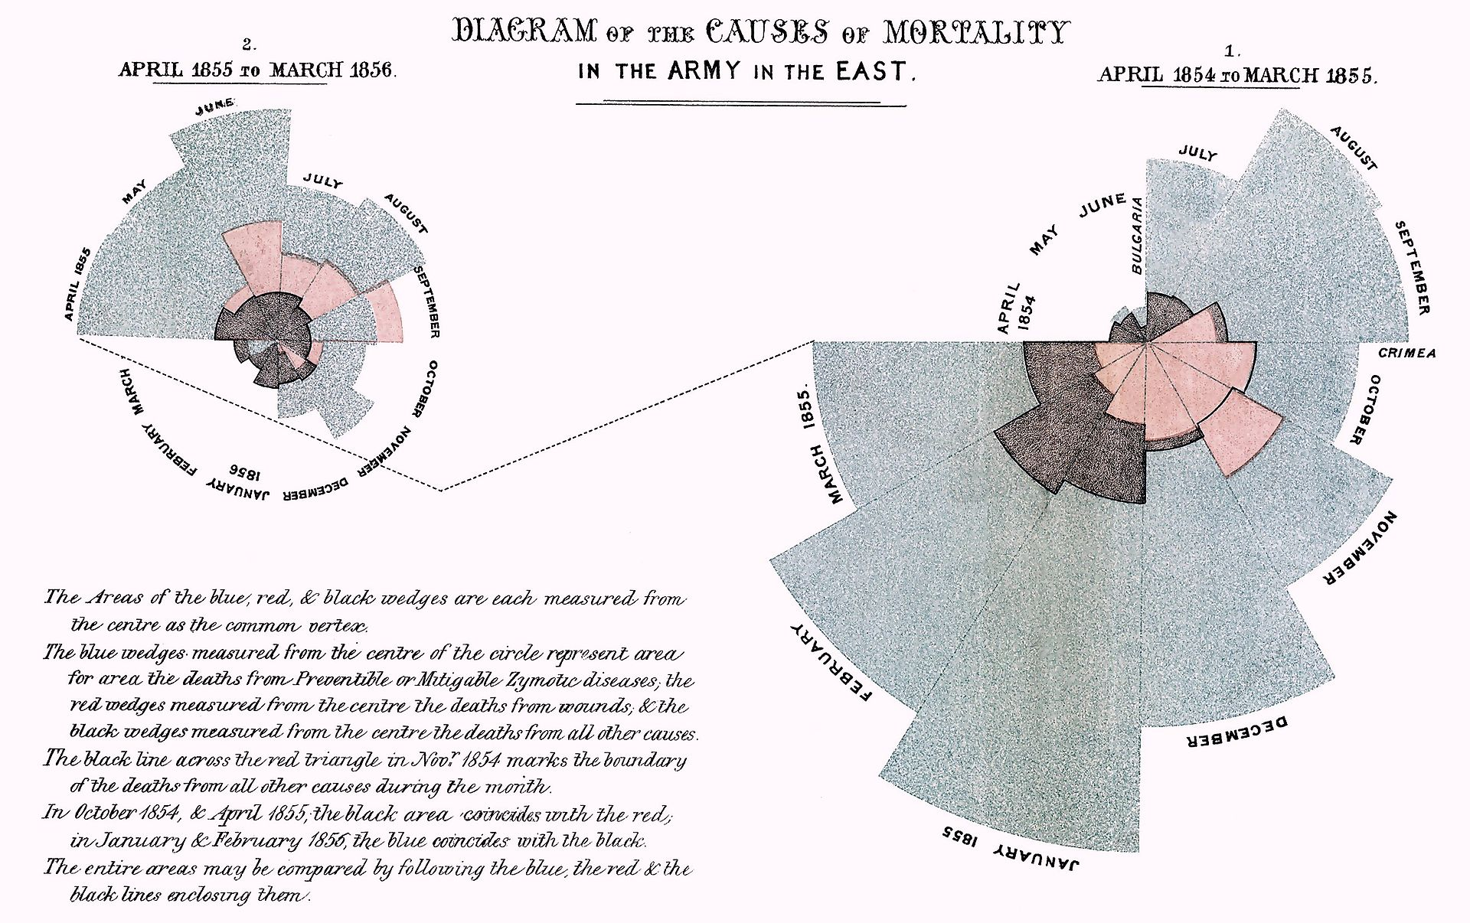
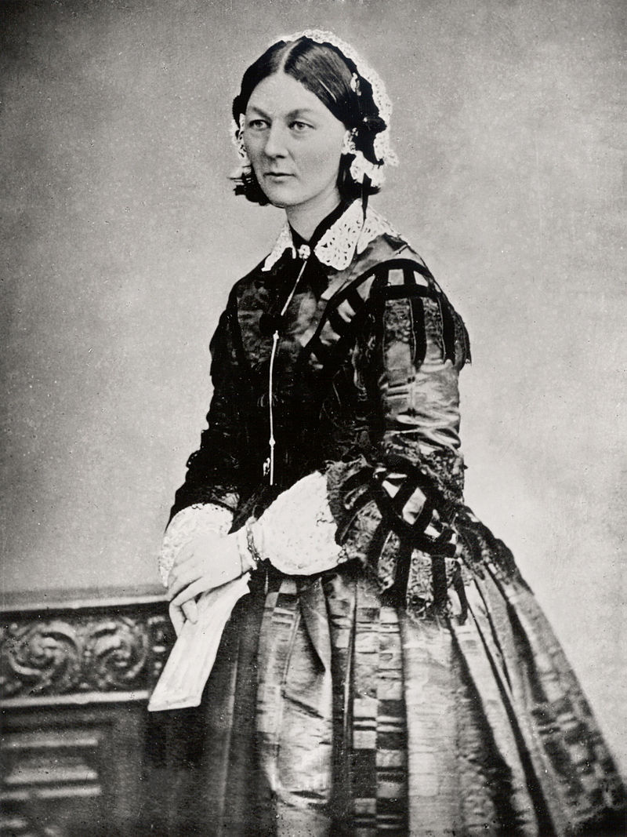
Florence Nightingale
https://en.wikipedia.org/wiki/Florence_Nightingale

Slide 5
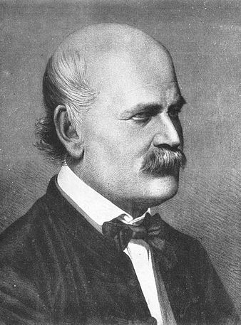
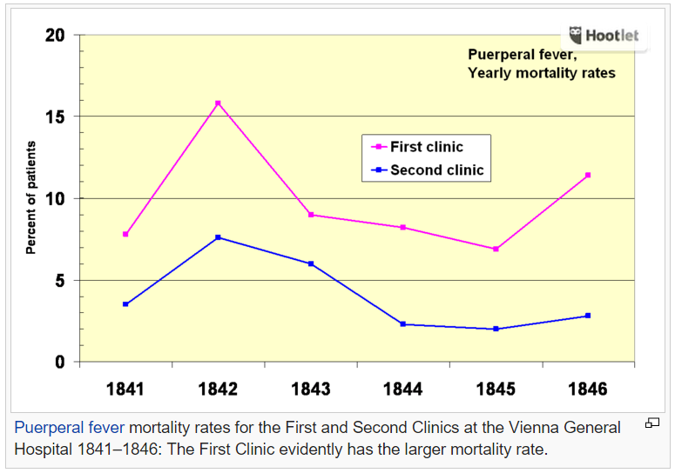
Ignoring the data
https://en.wikipedia.org/wiki/Ignaz_Semmelweis

Slide 6





Slide 7



Slide 8
Paired kidney donation

Slide 9
Paired kidney donation

Slide 10
Paired kidney donation

Slide 11


Measurement can’t do what you hoped for

Slide 12
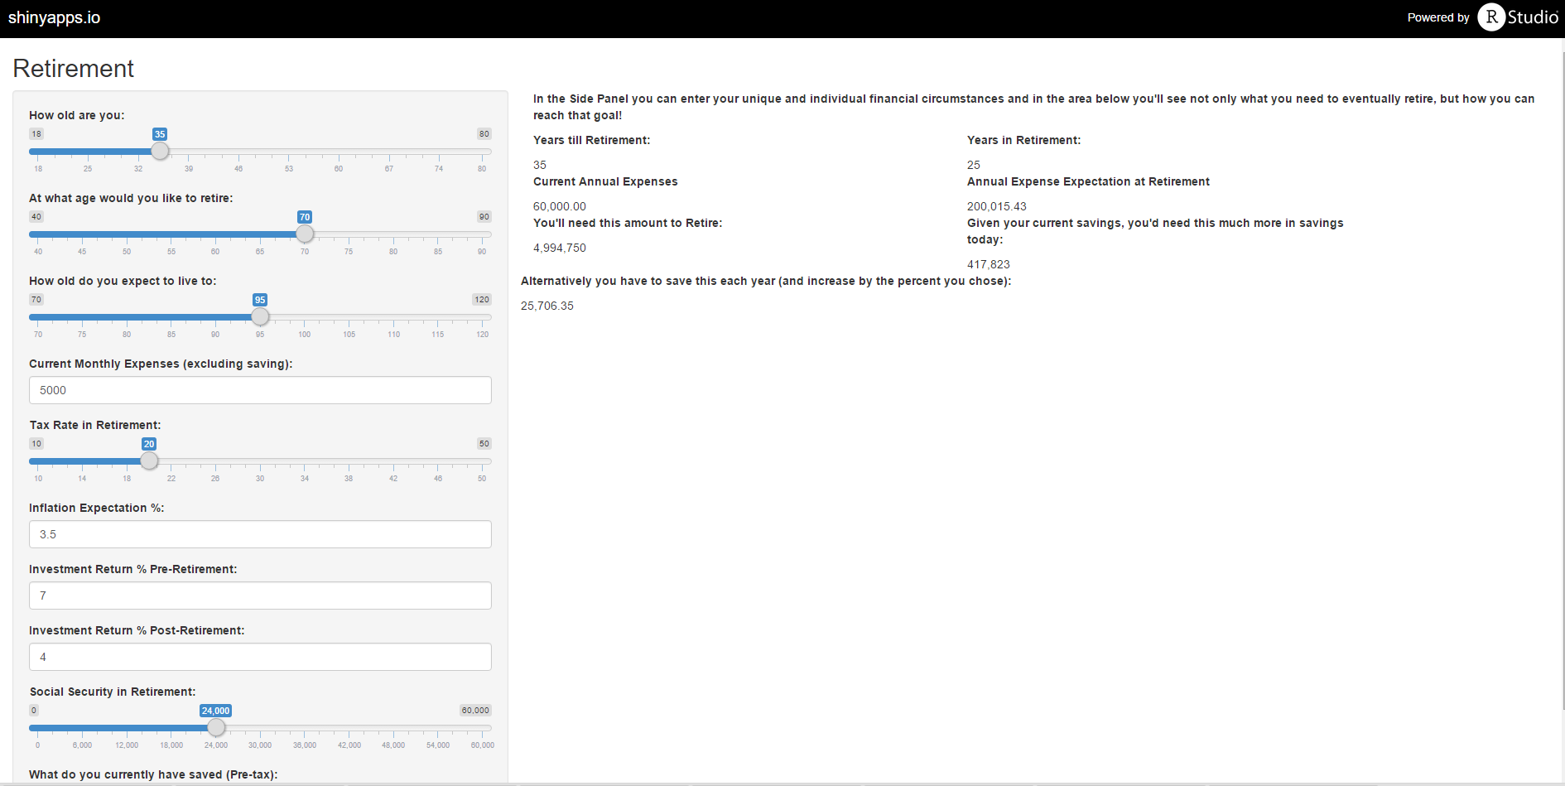
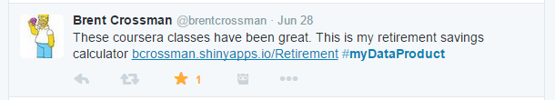

Impact

